Slide 1
Interference

Slide 2


Interference
Why do soap bubbles show vibrant color patterns, even though soapy water is colorless?
What causes the multicolored reflections from DVDs?
We will now look at optical effects, such as interference, that depend on the wave nature of light.
Notes:
1

Slide 3
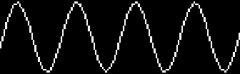
Waves
Wave:
variation (disturbance) of physical quantity that propagates through space
often: oscillation in space and time
y
phase of this wave
x
Superposition principle:
When two or more waves overlap, the resultant displacement at any instant is the sum of the displacements of each of the individual waves.

Slide 4
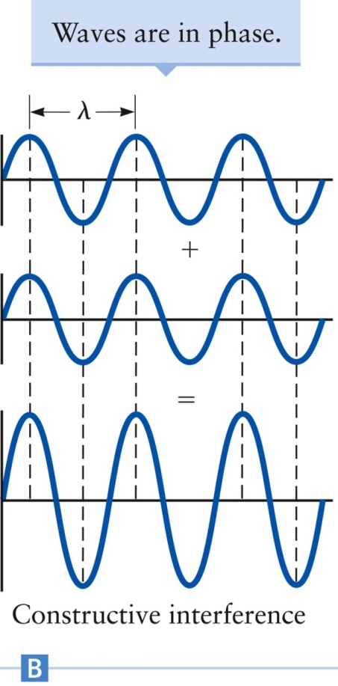
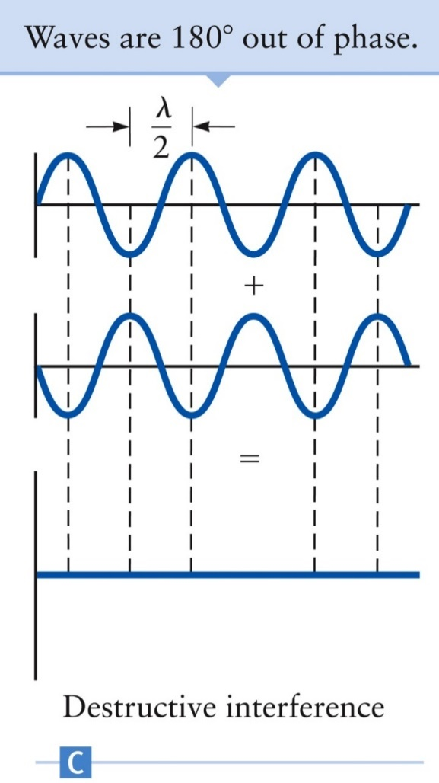
Constructive and destructive interference
Constructive interference occurs when the path difference is an integral number of wavelengths.
Destructive interference occurs when the path difference is a half-integral number of wavelengths.

Slide 5
Interference Requirements
Need two (or more) waves
Must have same frequency
Must be coherent (i.e. waves must have definite phase relation)

Slide 6
Demo: Interference for Sound …
For example, a pair of speakers, driven in phase, producing a tone of a single f and λ:
hmmm… I’m just far enough away that l₂-l₁=λ/2, and I hear no sound at all!
l₁
l₂
But this won’t work for light--can’t get coherent sources
Notes:
Demo 440 Sound Interference

Slide 7
Interference for Light …
Can’t produce coherent light from separate sources. (f ≈ 10¹⁴ Hz)
Need two waves from single source taking two different paths
Two slits
Reflection (thin films)
Diffraction*

Slide 8
Young’s double slit/rays
Monochromatic light travels through 2 slits onto a screen
What pattern emerges on the screen?
Shadow
Bright spots
This is not what is actually seen!

Slide 9
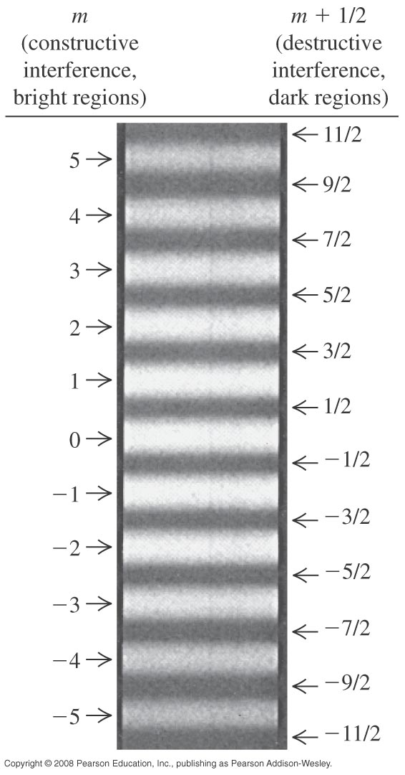
Young’s double slit/Huygens
Recall Huygens’ principle: Every point on a wave front acts as a source of tiny wavelets that move forward.
Bright and dark spots on screen!
•
Constructive = bright
•
Destructive = dark
Wave crests in phase = constructive interference

Slide 10
Young’s double slit: Key idea
Consider two rays traveling at an angle θ:
•
θ
•
Bottom ray travels a little further (2λ in this case)
Key for interference is this small extra distance.

Slide 11
For an infinitely distant* screen:
L₁
y
L₁
θ
S₁
L₂
θ
θ
d
θ
P
d
L₂
ΔL
ΔL = L₂ –L₁ = d sin θ
S₂
*so that all the angles labeled θ are approximately equal
R

Slide 12
Constructive Interference:
L₁
θ
θ
d
Destructive Interference:
L₂
ΔL = L₂ –L₁ = d sin θ
The parameter m is called the order of the interference fringe. The central bright fringe at θ = 0 (m = 0) is known as the zeroth-order maximum. The first maximum on either side (m = ±1) is called the first-order maximum.

Slide 13
For small angles:
L₁
θ
y
Bright fringes:
S₁
L₂
θ
d
P
ΔL
S₂
This is not a starting equation!
R
Do not use the small-angle approximation unless it is valid!

Slide 14
For small angles:
L₁
θ
y
Dark fringes:
S₁
L₂
θ
d
P
ΔL
S₂
This is not a starting equation!
R
Do not use the small-angle approximation unless it is valid!

Slide 15
Example: a viewing screen is separated from the double-slit source by 1.2 m. The distance between the two slits is 0.030 mm. The second-order bright fringe (m = 2) is 4.5 cm from the center line. Determine the wavelength of the light.
Bright fringes:
L₁
θ
y
S₁
L₂
θ
d
P
S₂
ΔL
R

Slide 16
Example: a viewing screen is separated from the double-slit source by 1.2 m. The distance between the two slits is 0.030 mm. The second-order bright fringe (m = 2) is 4.5 cm from the center line. Find the distance between adjacent bright fringes.
L₁
Bright fringes:
θ
y
S₁
L₂
θ
d
P
S₂
ΔL
R

Slide 17
Example: a viewing screen is separated from the double-slit source by 1.2 m. The distance between the two slits is 0.030 mm. The second-order bright fringe (m = 2) is 4.5 cm from the center line. Find the width of the bright fringes.
Define the bright fringe width to be the distance between two adjacent destructive minima.
L₁
θ
y
S₁
L₂
θ
d
P
S₂
ΔL
R

Slide 18
In a Young’s double-slit experiment, the angle that locates the second dark fringe on the either side of the central bright fringe is 5.4º. Find the ratio of the slit separation to the wavelength of the light.
Example
For destructive interference
(m + 1/2)λ= d sin θ.
For the second dark fringe, m = 1 so

Slide 19
In a Young’s double-slit experiment the separation y between the first-order bright fringe and the central fringe is 0.0240 m, when the light has a wavelength of 475 nm. Assume that angles are small enough so sin θ ≈ tan θ. Find the separation y when the light has a wavelength of 611 nm.
Example
We have that y = L tan θ . Since for small angles, tan θ ≈ sin θ = λ /d, y = (L/d) λ. The first case gives
L/d = y/ λ = (2.40 x 10^{–2} m)/(475 x 10^{–9} m) = 5.05 x 10⁴
Then the fringe separation in the second case is
y = (5.05 x 10⁴)(611 x 10^{–9} m) = 0.0309 m.

Slide 20
Young’s Double Slit
Light waves from a single source travel through 2 slits before meeting on a screen. The interference will be:
Constructive
Destructive
Depends on L
d
Single source of monochromatic light λ
L
2 slits-separated by d
Screen a distance L from slits

Slide 21
Example
The experiment is modified so that one of the waves has its phase shifted by ½ λ. Now, the interference will be:
Constructive
Destructive
Depends on L
½ λ shift
d
Single source of monochromatic light λ
L
2 slits-separated by d
Screen a distance L from slits
Notes:
60% got this correct

Slide 22
Example
When this Young’s double slit experiment is placed under water, the separation y between minima and maxima:
m = +2
y
m = +1
θ
θ
d
m = 0
dsin(θ)
L
m = -1
m = -2
1) increases 2) same 3) decreases

Slide 23
Example
In the Young double slit experiment, is it possible to see interference maxima when the distance between slits is smaller than the wavelength of light?
1) Yes 2) No

Slide 24
Intensity in Double Slit Interference Pattern
P
The electric field at P is E = E₁ + E₂
E = E_{P} sin (ωt) + E_{P} sin (ωt + φ)
E = E_{P} [sin (ωt) + sin (ωt + φ)]
r₁
y
r₂
d
θ
R or L
This expression can be transformed using:
sin α + sin β = 2 [sin (α + β) / 2] [cos (α - β) / 2]
with α = ωt and β = ωt + φ
E = 2 E_{p} cos (φ /2) sin (ωt + φ /2)

Slide 25
Intensity in Double Slit Interference Pattern
P
The electric field at P is E = E₁ + E₂
r₁
y
r₂
E = 2 E_{p} cos (φ /2) sin (ωt + φ /2)
d
θ
R or L
Path difference is d sin θ ⇒ φ / 2π = d sin θ / λ ⇒
E = 2 E_{P} cos [π d sin θ / λ] sin (ωt + φ /2)

Slide 26
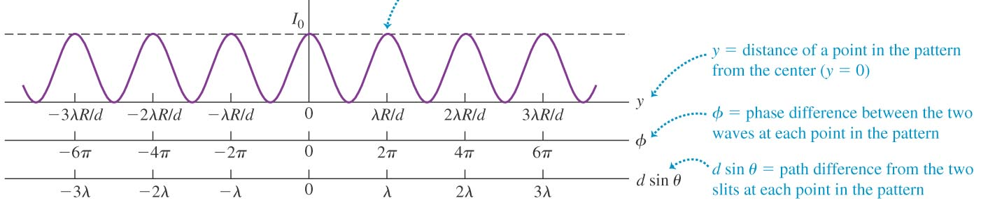
Intensity in Double Slit Interference Pattern
Finally, then, the intensity pattern is

Slide 27
Multiple Slits: (Diffraction Grating – N slits with spacing d)
Assume screen is very far away (L>>d):
L
1
θ
2
d
3
θ
d
4
d
= d sinθ
=λ
Path length difference 1-2
= 2d sinθ
=2λ
Path length difference 1-3
= 3d sinθ
=3λ
Path length difference 1-4
Constructive interference for all paths when
dsin(θ) = mλ
m = 0, ±1, ±2

Slide 28
Multiple Slits: (Diffraction Grating – N slits with spacing d)
Assume screen is very far away (L>>d):
L
1
θ
2
d
3
θ
d
4
d
d
Constructive: dsin(θ) = mλ
m = 0, ±1, ±2
d
d
Same condition as Young’s double slit!
Holds for arbitrary N

Slide 29
Example
L
1
θ
2
d
3
θ
d
All 3 rays are interfering constructively at the point shown. If the intensity from ray 1 is I₀ , what is the combined intensity of all 3 rays? 1) I₀ 2) 3 I₀ 3) 9 I₀

Slide 30
Example
L
1
θ
2
d
3
θ
d
When rays 1 and 2 are interfering destructively, is the intensity from the three rays a minimum? 1) Yes 2) No

Slide 31
Three slit interference
9I₀
I₀

Slide 32
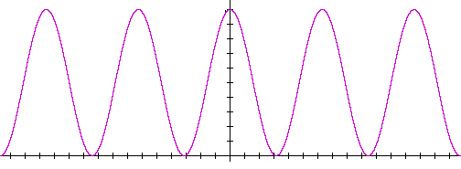
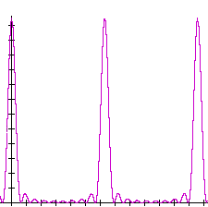
Multiple Slit Interference (Diffraction Grating)
Peak location depends on wavelength!
For many slits, maxima are still at
Region between maxima gets suppressed more and more as no. of slits increases – bright fringes become narrower and brighter.
2 slits (N=2)
10 slits (N=10)
intensity
intensity
0
λ
2λ
0
λ
2λ
Notes:
Here do demo using diffraction grating for red and green laser

Slide 33
Multiple Slit Interference
With more than two slits, things get a little more complicated
P
y
d
L
Notes:
27
26

Slide 34
Multiple Slit Interference
With more than two slits, things get a little more complicated
Now to get a bright
fringe, many paths
must all be in phase.
The brightest fringes
become narrower but
brighter;
and extra lines show up
between them.
P
y
d
L
Notes:
28
26

Slide 35
Multiple Slit Interference
With more than two slits, things get a little more complicated
Now to get a bright
fringe, many paths
must all be in phase.
The brightest fringes
become narrower but
brighter;
and extra lines show up
between them.
P
y
d
L
Such an array of slits is called a “Diffraction Grating”
Notes:
28
26

Slide 36
Multiple Slit Interference
All of the lines show up at the set of angles given by:
d sinθ = (m/N) λ
(N = number of slits). Most of these are not too bright.
The very bright ones are for m a multiple of N.
won’t worry about the math here, just look at the
general form:
S
θ
Notes:
31
26

Slide 37
Thin Film Interference

Slide 38
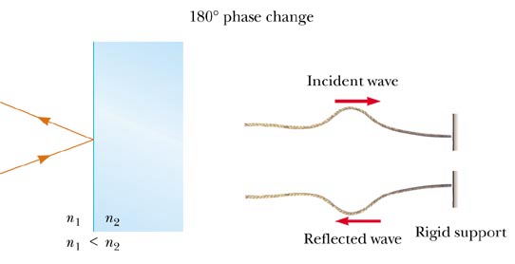
Phase Changes Due To Reflection
An electromagnetic wave undergoes a phase change of 180° upon reflection from a medium of higher index of refraction than the one in which it was traveling (similar to a reflected pulse on a string

Slide 39
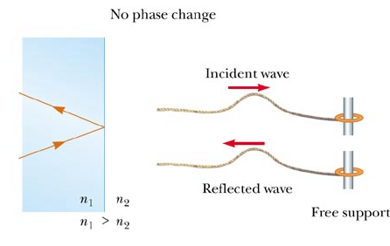
Phase Changes Due To Reflection
There is no phase change when the wave is reflected from a boundary leading to a medium of lower index of refraction (similar to a pulse in a string reflecting from a free support)

Slide 40
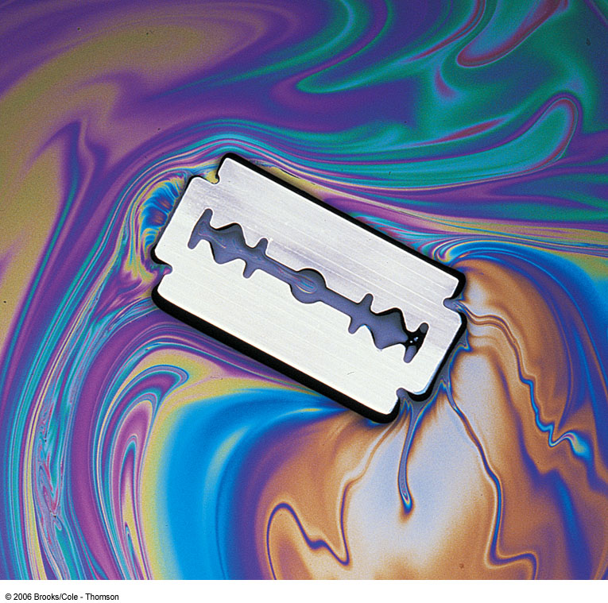
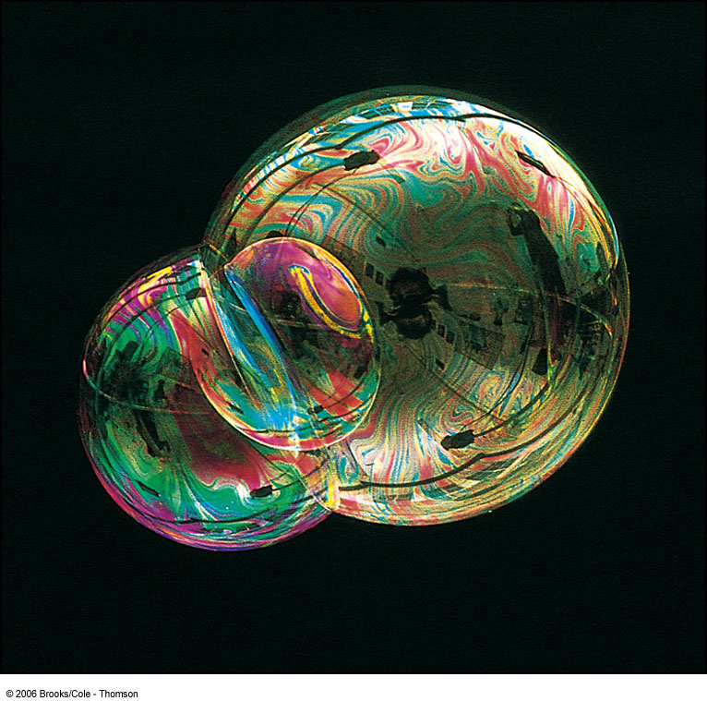
Interference in Thin Films

Slide 41
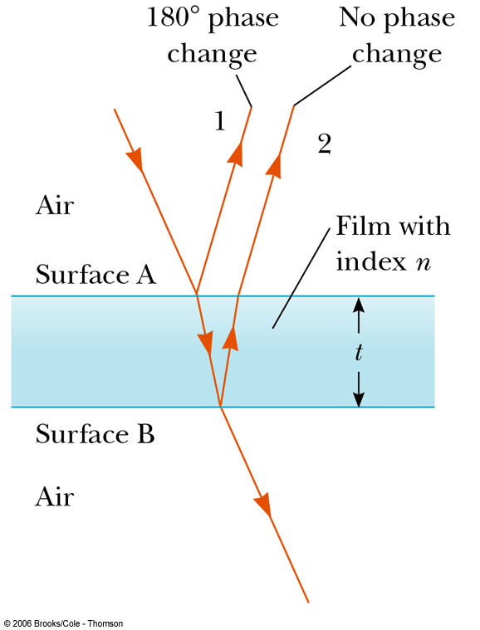
Interference in Thin Films
Interference effects are commonly observed in thin films (e.g., soap bubbles, oil on water, etc.)
The interference is due to the interaction of the waves reflected from both surfaces of the film
Recall: the wavelength of light λ_{n} in a medium with index of refraction n is λ_{n} = λ / n where λ is the wavelength of light in vacuum

Slide 42
Interference in Thin Films
Recall: an electromagnetic wave traveling from a medium of index of refraction n₁ toward a medium of index of refraction n₂ undergoes a 180° phase change on reflection when n₂ > n₁ and there is no phase change in the reflected wave if n₂ < n₁
Ray 1 undergoes a phase change of 180° with respect to the incident ray

Slide 43
Interference in Thin Films
Ray 2, which is reflected from the lower surface, undergoes no phase change with respect to the incident wave
Ray 2 also travels an additional distance of 2t before the waves recombine
For constructive interference, taking into account the 180° phase change and the difference in optical path length for the two rays:
2 n t = (m + ½) λ; m = 0, 1, 2 …

Slide 44
Interference in Thin Films
Ray 2, which is reflected from the lower surface, undergoes no phase change with respect to the incident wave
Ray 2 also travels an additional distance of 2t before the waves recombine
For destructive interference
2 n t = m λ; m = 0, 1, 2 …

Slide 45
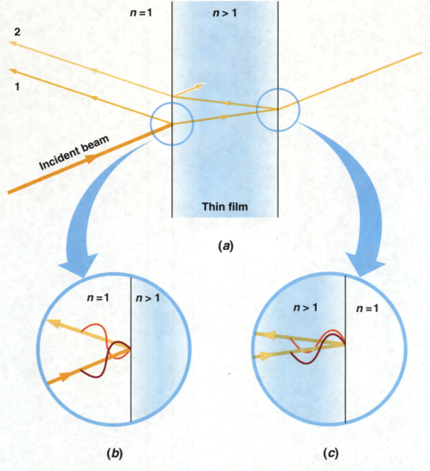
Interference in Thin Films
Two factors influence thin film interference: possible phase reversals on reflection and differences in travel distance
The conditions are valid if the medium above the top surface is the same as the medium below the bottom surface
If the thin film is between two different media, one of lower index than the film and one of higher index, the conditions for constructive and destructive interference are reversed

Slide 46
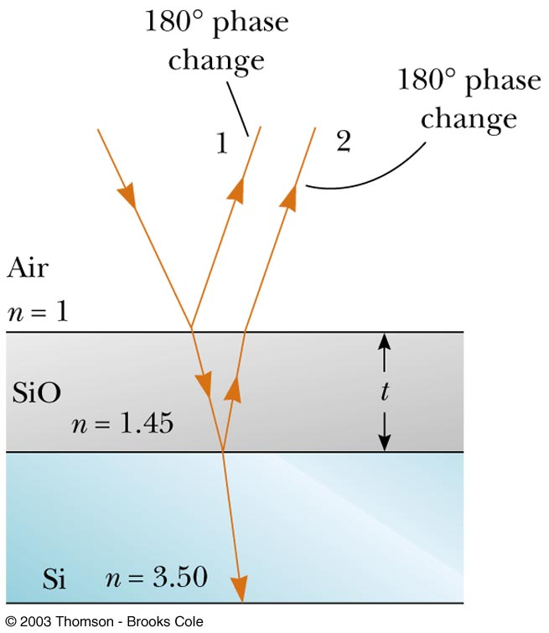
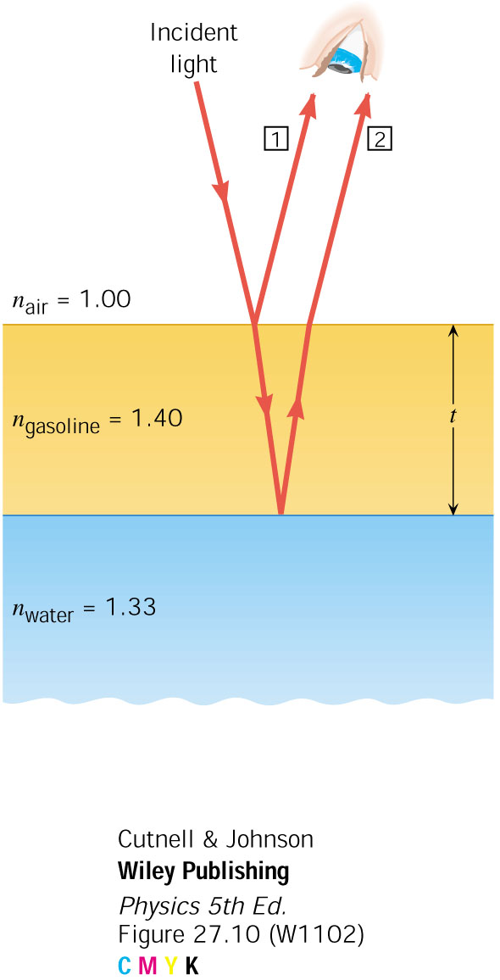
Interference in Thin Films, Example
Phase change
NO Phase change

Slide 47
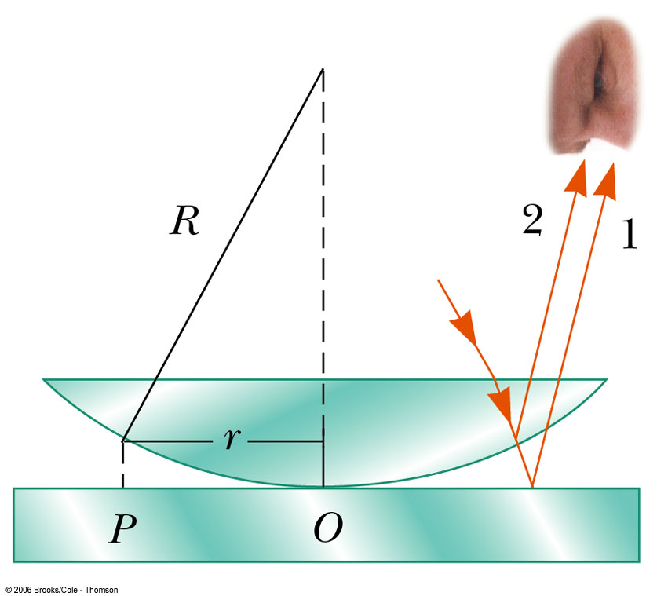
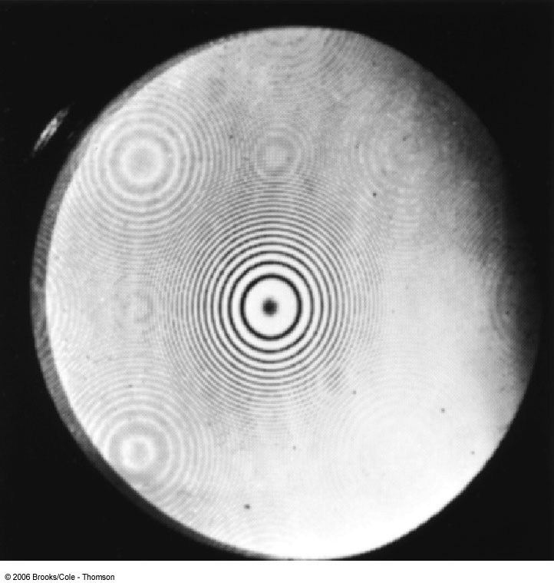
Newton’s Rings
Another method for viewing interference is to place a planoconvex lens on top of a flat glass surface
The air film between the glass surfaces varies in thickness from zero at the point of contact to some thickness t
A pattern of light and dark rings – Newton’s Rings – is observed
Newton’s Rings can be used to test optical lenses

Slide 48
Problem Solving for Thin Films
Identify the thin film causing the interference
Determine the indices of refraction in the film and the media on either side of it
Determine the number of phase reversals: zero, one or two
The interference is constructive if the path difference is an integral multiple of λ and destructive if the path difference is an odd half multiple of λ
The conditions are reversed if one of the waves undergoes a phase change on reflection

Slide 49
Problem Solving for Thin Films
Equation | 1 phase reversal | 0 or 2 phase reversals
2 n t = (m + ½) λ | constructive | destructive
2 n t = m λ | destructive | constructive

Slide 50
Interference in Thin Films
Constructive interference in thin films:
Destructive interference in thin films:

Slide 51
Example. A soap film with different thicknesses at different places has an unknown refractive index n and air on both sides. In reflected light it looks multicolored. One region looks yellow because destructive interference has removed blue (λ_{vacuum} = 469 nm) from reflected light, while another looks magenta because destructive interference has removed green (λ_{vacuum}= 555 nm). In these regions the film has the minimum nonzero thickness t required for destructive interference to occur. Find the ratio t_{magenta}/t_{yellow}.
The phase change occurs at the top surface of the film, where the light first strikes it. However, no phase change occurs when light that has penetrated the film reflects back upward from the bottom surface. To evaluate destructive interference correctly, we must consider a net phase change of ½ λfilm due to reflection as well as the extra distance traveled by the light within the film.

Slide 52
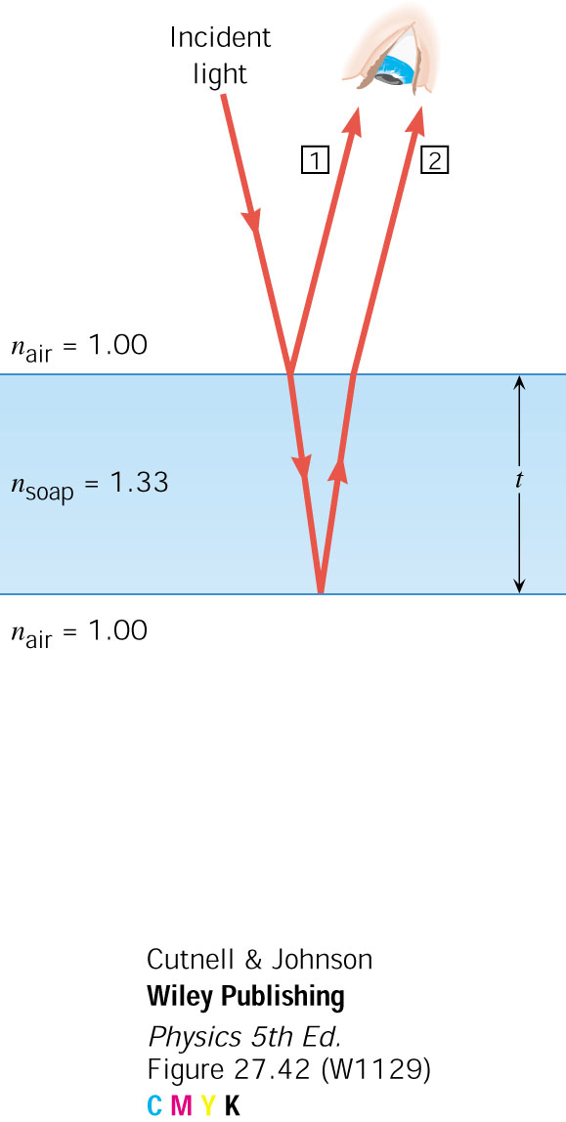
##. Solution
At perpendicular incidence, ray 2 travels a distance of 2t further than ray 1, where t is the thickness of the film. In addition, the net path change for the two rays is ½ λfilm. For destructive interference, the combined total must be an odd-integer number of half-wavelengths in the film:
Subtracting the term from the left side of this equation and from each term on the right side, we obtain
The minimum nonzero thickness is t = λfilm/2.

Slide 53
##. Solution
But the wavelength in the film is related to the vacuum-wavelength according to λfilm = λvacuum/n. Thus, the minimum nonzero thickness is
t = λvacuum/(2n)
Applying this result to both regions of the film allows us to obtain the desired ratio:

Slide 54
Example 2. Orange light (λ_{vacuum} = 611 nm) shines on soap film (n = 1.33) that has air on either side of it. The light strikes the film perpendicularly. What is the minimum thickness of the film for which constructive interference causes it to look bright in reflected light?
For the reflection at the top film surface, the light travels from air, where the refractive index is smaller (n = 1.00), toward the film, where the refractive index is larger (n = 1.33). Associated with this reflection there is a phase change that is equivalent to ½ λfilm . For the reflection at the bottom film surface, there is NO phase change. As a result of these two reflections, there is a net phase change that is equivalent to ½λfilm. To obtain the condition for constructive interference, this net phase change must be added to the phase change that arises because of the film thickness t, which is traversed twice by the light that penetrates it.

Slide 55
&&. Solution
For constructive interference we find that
and we know λfilm = λvacuum/n
Using this expression and the fact that m = 0 for the minimum thickness t, we find that the condition for constructive interference becomes

Slide 56
Interference in Thin Films
Constructive interference in thin films:
Destructive interference in thin films:

Slide 57
Example 3. A mixture of yellow (λ_{yellow} = 580 nm in vacuum) and violet light (λ_{violet} = 410 nm in vacuum)falls perpendicular on the gasoline that is floating on a puddle of water. For both wavelengths, the refractive index of gasoline is n=1.40 and that of water is n= 1.33. What is the minimum nonzero thickness of the film in a spot that looks (a) yellow and (b) violet because of destructive interference?
(a) For removal of violet light, which makes the film look yellow,
The condition for destructive interference with the minimum nonzero thickness of the film is
2t = λfilm
t = λvacuum/2n
(b) For removal of yellow light, which makes the film look violet,

Slide 58



Example: Thickness of a Soap Film
Consider a bubble formed from a thin, soapy film that looks blue when viewed at normal incidence. Estimate the thickness of the film. Assume its index of refraction is n_{film}=1.35 and blue light has a wavelength λ_{blue}=400 nm. Also assume the film is so thin that thinner films are not able to give constructive interference.
Solution:
The interference here is destructive and we consider m=0:

Slide 59

Example
Blue light (λ₀ = 500 nm) incident on a glass (n₁ = 1.5) cover slip (t = 167 nm) floating on top of water (n₂ = 1.3).
1
2
n = 1.0 (air)
t
n₁ (thin film)
n₂
What is δ₁, the total phase shift for ray 1
A) δ₁ = 0 B) δ₁ = ½ C) δ₁ = 1

Slide 60
Example
Blue light (λ₀ = 500 nm) incident on a glass (n₁ = 1.5) cover slip (t = 167 nm) floating on top of water (n₂ = 1.3).
1
2
n = 1.0 (air)
t
n₁ (thin film)
n₂
Is the interference constructive or destructive or neither?
δ₁ =
δ₂ =
Phase shift = |δ₂ – δ₁| =

Slide 61
Example
Blue light (λ₀ = 500 nm) incident on a glass (n₁ = 1.5) cover slip (t = 167 nm) floating on top of plastic (n₂ = 1.8).
1
2
n = 1.0 (air)
t
n₁ (thin film)
n₂
Is the interference : 1) constructive 2) destructive 3) neither?
δ₁ =
δ₂ =
Phase shift = |δ₂ – δ₁| =

Slide 62
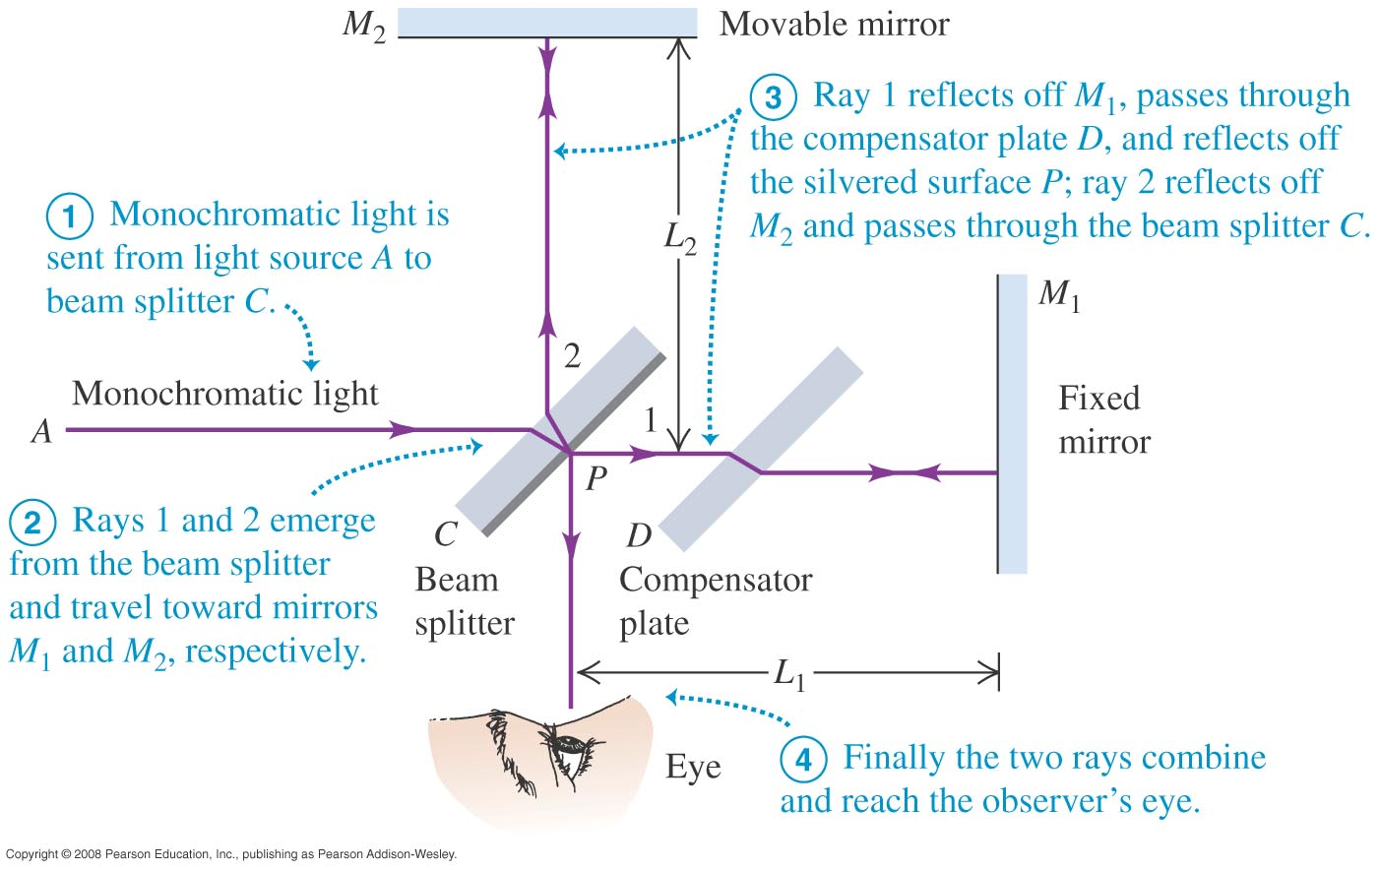
Michelson interferometer
The Michelson interferometer is used to make precise measurements of wavelengths and very small distances.
Follow the text analysis, using Figure below.

Slide 63
Diffraction

Slide 64
Diffraction
What happens when a planar wavefront of light interacts with an aperture?
If the aperture is large
compared to the wavelength you
would expect this....
…Light propagating
in a straight path.

Slide 65
Diffraction
If the aperture is small
compared to the wavelength
would you expect this?
Not really…

Slide 66
Diffraction
If the aperture is small compared to the wavelength,
would you expect the same straight propagation? … Not really
In fact, what happens
is that: a spherical
wave propagates out
from the aperture.
All waves behave
this way.
This phenomenon of light spreading in a broad pattern,
instead of following a straight path, is called: DIFFRACTION

Slide 67
Diffraction
I
Slit width a:
θ
(Actual
intensity
distribution)
Angular Spread: θ ~ λ/a

Slide 68
Huygen’s Principle
Huygen first explained this in 1678 by proposing that all planar wavefronts are made up of lots of spherical wavefronts..

Slide 69
Huygen’s Principle
Huygen first explained this in 1678 by proposing that all planar wavefronts are made up of lots of spherical wavefronts..
That is, you see how light propagates
by breaking a wavefront into little
bits

Slide 70
Huygen’s Principle
Huygen first explained this in 1678 by proposing that all planar wavefronts are made up of lots of spherical wavefronts..
That is, you see how light propagates
by breaking a wavefront into little
bits, and then draw a spherical wave
emanating outward from each little
bit.

Slide 71
Huygen’s Principle
Huygen first explained this in 1678 by proposing that all planar wavefronts are made up of lots of spherical wavefronts..
That is, you see how light propagates
by breaking a wavefront into little
bits, and then draw a spherical wave
emanating outward from each little
bit. You then can find the leading edge
a little later simply by summing all
these little “wavelets”

Slide 72
Huygen’s Principle
Huygen first explained this in 1678 by proposing that all planar wavefronts are made up of lots of spherical wavefronts..
That is, you see how light propagates
by breaking a wavefront into little
bits, and then draw a spherical wave
emanating outward from each little
bit. You then can find the leading edge
a little later simply by summing all
these little “wavelets”
It is possible to explain reflection and refraction this way too.

Slide 73
Diffraction at Edges
what happens to the
shape of the field at this
point?

Slide 74
Diffraction at Edges
Light gets diffracted at the edge of an opaque barrier
⇒ there is light in the region obstructed by the barrier
I

Slide 75
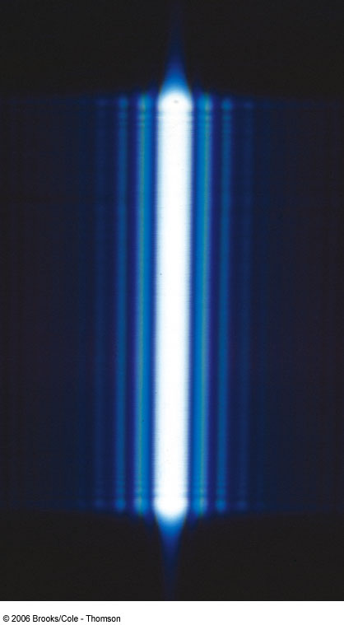
Diffraction
A single slit placed between a distant light source and a screen produces a diffraction pattern
It has a broad, intense central band
The central band is flanked by a series of narrower, less intense secondary bands called secondary maxima
The central band will also be flanked by a series of dark bands called minima
This result cannot be explained by geometric optics

Slide 76
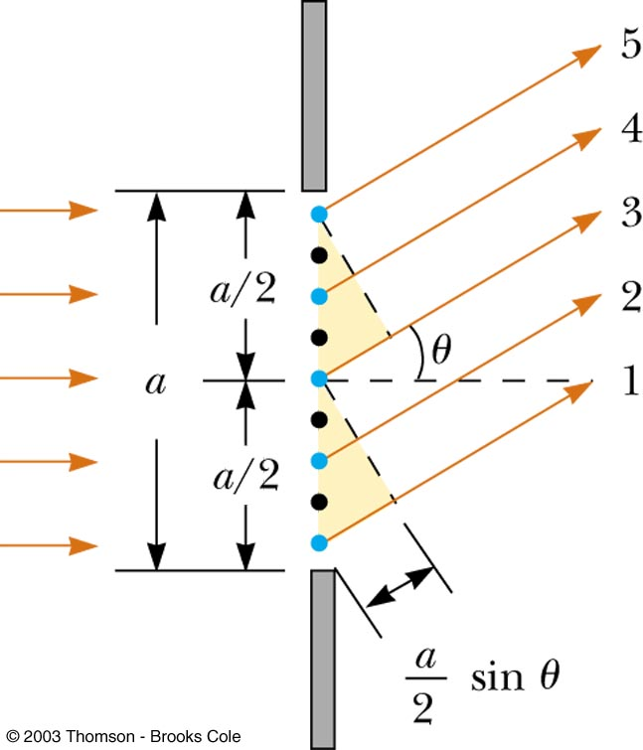
Single Slit Diffraction
According to Huygen’s principle, each portion of the slit acts as a source of waves
The light from one portion of the slit can interfere with light from another portion
The resultant intensity on the screen depends on the direction θ
All the waves that originate at the slit are in phase

Slide 77
Single Slit Diffraction
Wave 1 travels farther than wave 3 by an amount equal to the path difference (a / 2) sin θ
If this path difference is exactly half of a wavelength, the two waves cancel each other and destructive interference results
In general, destructive interference occurs for a single slit of width a when
sin θ_{dark} = mλ / a; m = ±1, ±2, …

Slide 78
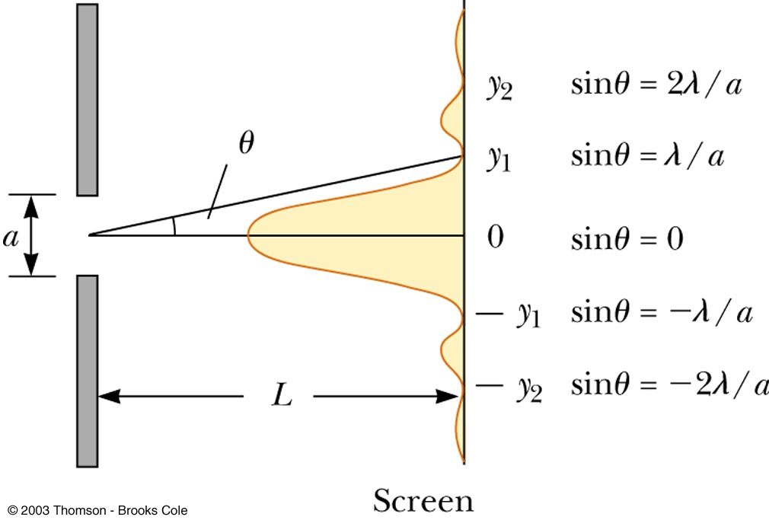
Single Slit Diffraction
The general features of the intensity distribution are shown
A broad central bright fringe is flanked by much weaker bright fringes alternating with dark fringes
The points of constructive interference lie approximately halfway between the dark fringes

Slide 79
Example: Single Slit Diffraction
Light of wavelength λ = 500 nm is incident on a slit a=50 μm wide. How wide is the intensity distribution on the
screen, 50 cm away?
a
50 cm
What happens if the slit width is doubled?
The spread gets cut in half.

Slide 80
Problem
A screen is placed 50.0 cm from a single slit, which is illuminated with light of wavelength 680 nm. If the distance between the first and third minima in the diffraction pattern is 3.00 mm, what is the width of the slit?

Slide 81
Example: Light of wavelength 610 nm is incident on a slit 0.20 mm wide and the diffraction pattern is produced on a screen that is 1.5 m from the slit. What is the width of the central maximum?
Example: Light of wavelength 687 nm is incident on a single slit 0.75 mm wide. At what distance from the slit should a screen be placed if the second dark fringe in the diffraction pattern is to be 1.7 mm from the center of the screen?
A) 0.39 m B) 0.93 m C) 1.1 m D) 1.9 m

Slide 82
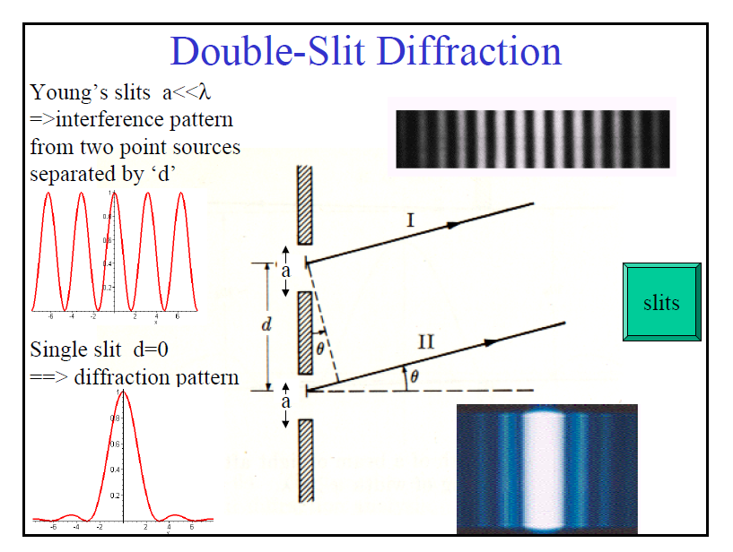

Slide 83
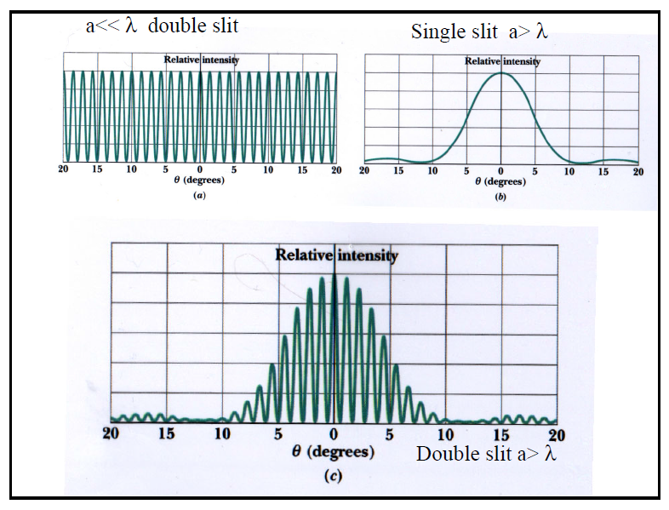

Slide 84
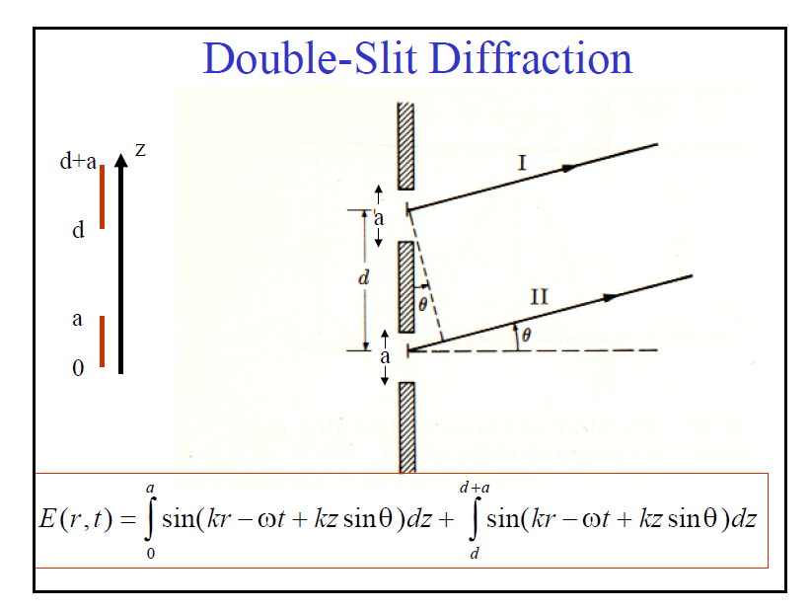

Slide 85
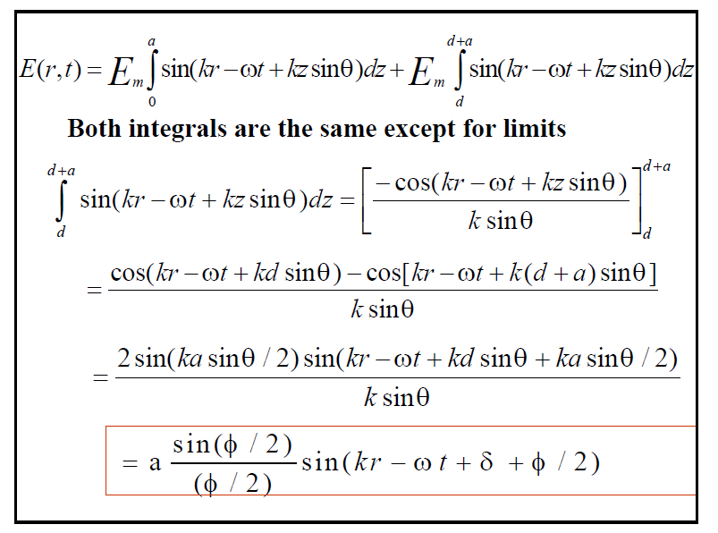

Slide 86
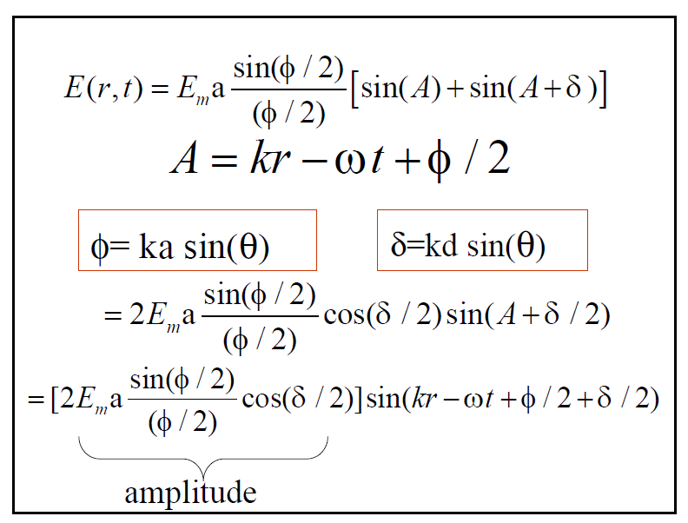

Slide 87
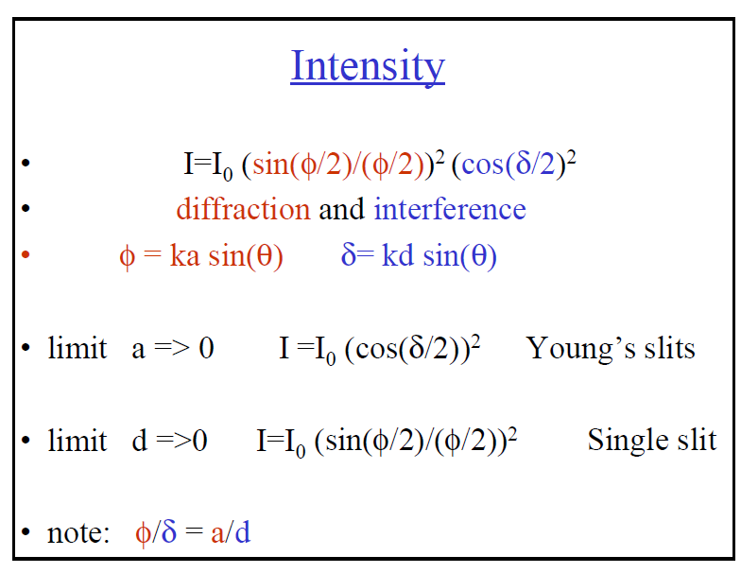

Slide 88
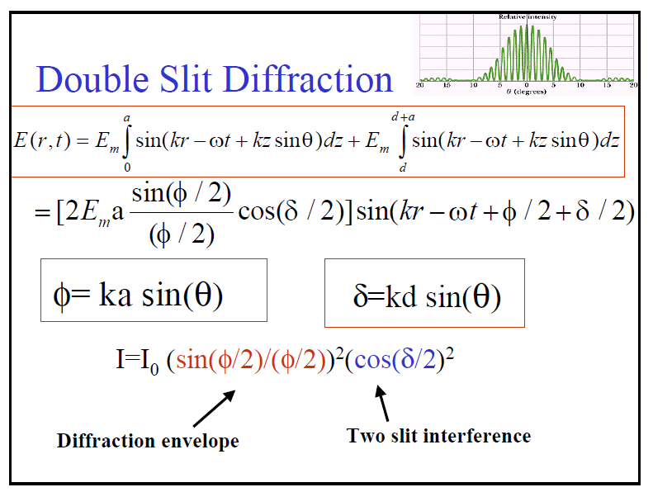

Slide 89
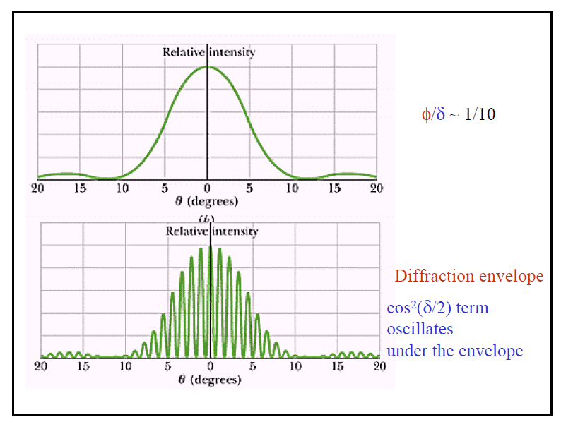

Slide 90
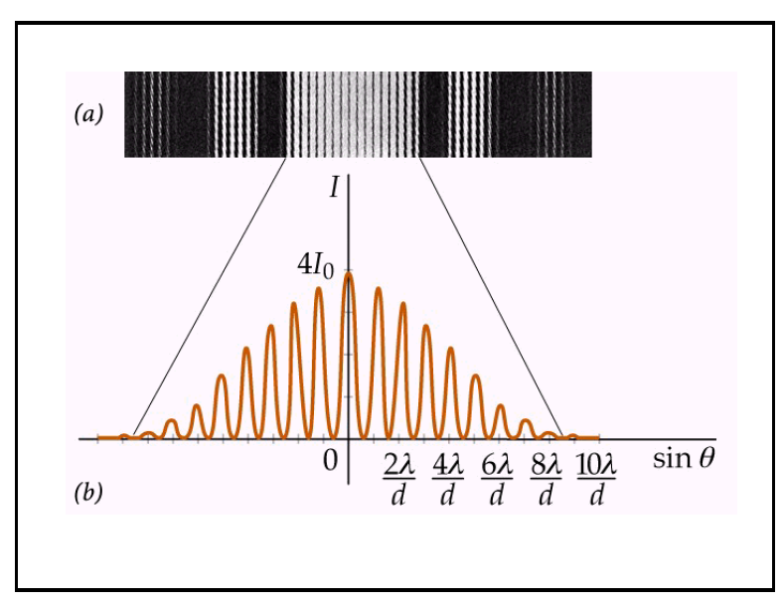

Slide 91
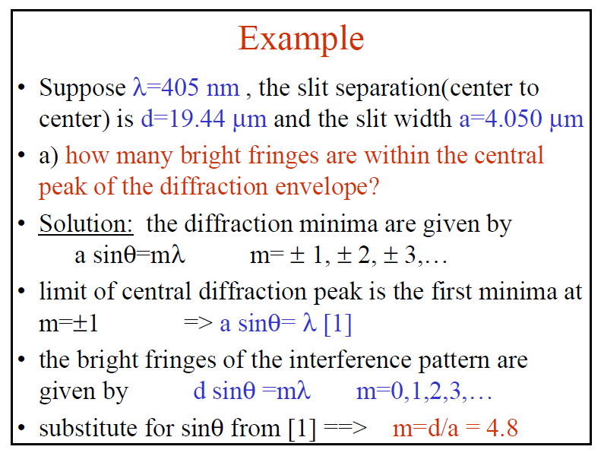

Slide 92
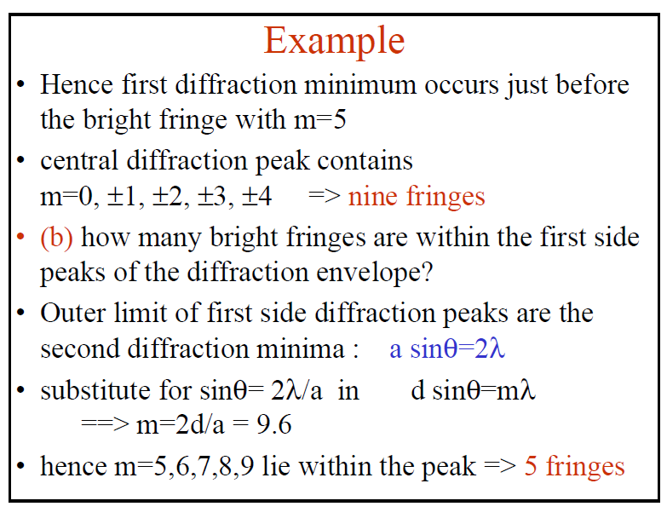

Slide 93
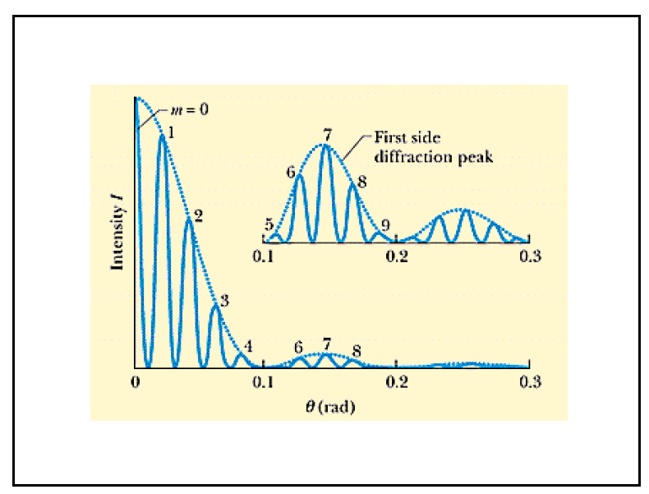

Slide 94
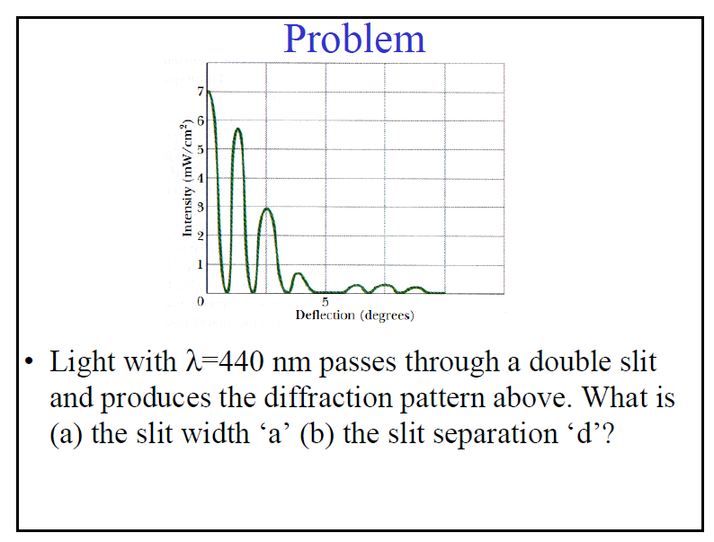

Slide 95
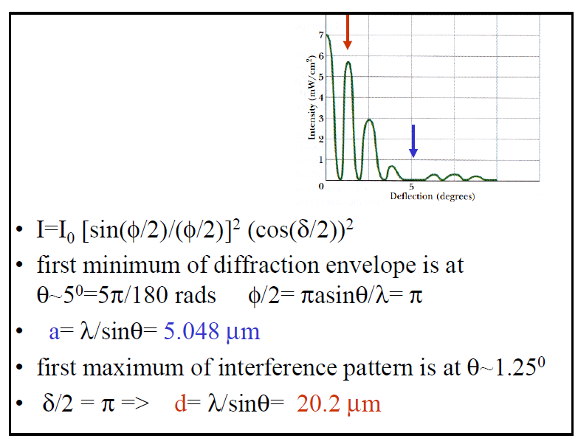

Slide 96
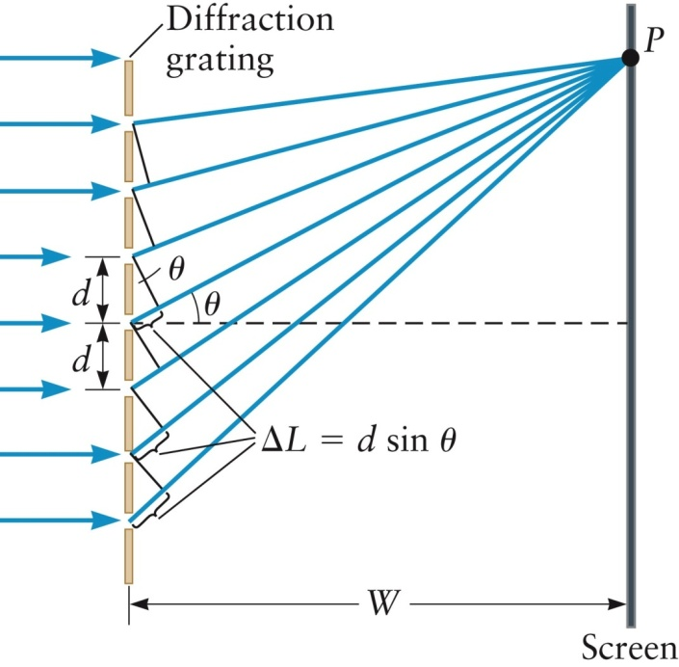
Diffraction Gratings
An arrangement of many slits is called a diffraction grating
Assumptions
The slits are narrow
Each one produces a single outgoing wave
The screen is very far away
If the slit-to-slit spacing is d, then the path length difference for the rays from two adjacent slits is
ΔL = d sinθ
If ΔL is equal to an integral number of wavelengths, constructive interference occurs
For a bright fringe, d sin θ = m λ (m = 0, ±1, ±2, …)

Slide 97
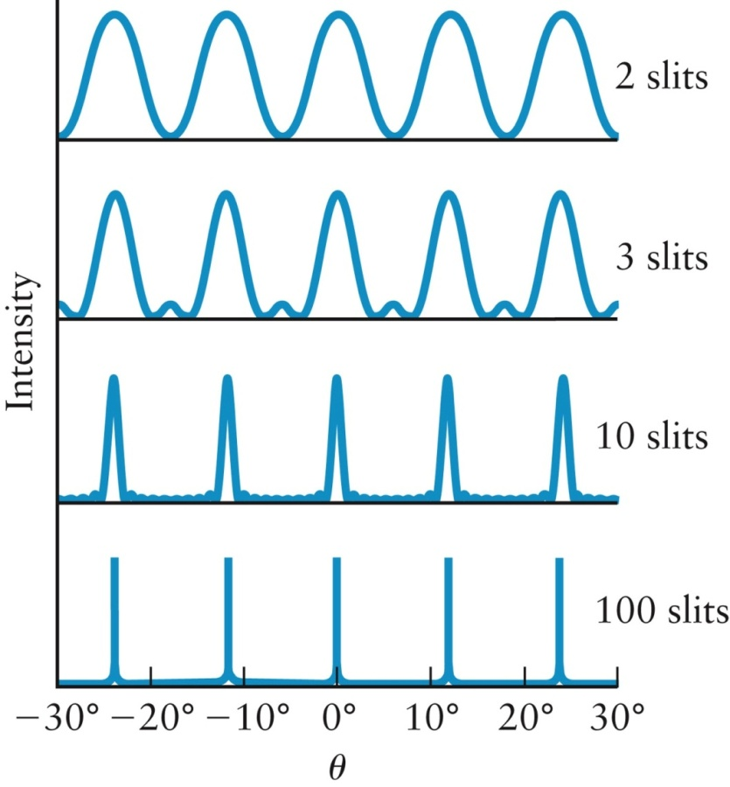
The condition for bright fringes from a diffraction grating is identical to the condition for constructive interference from a double slit
The overall intensity pattern depends on the number of slits
The larger the number of slits, the narrower the peaks

Slide 98
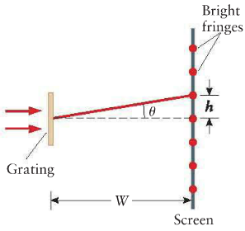




Example: Diffraction of Light by a Grating
A diffraction experiment is carried out with a grating. Using light from a red laser (λ = 630 nm), the diffraction fringes are separated by h=0.15 m on a screen that is W=2.0 m from the grating. Find the spacing d between slits in the grating.
Solution:

Slide 99
Polarization

Slide 100
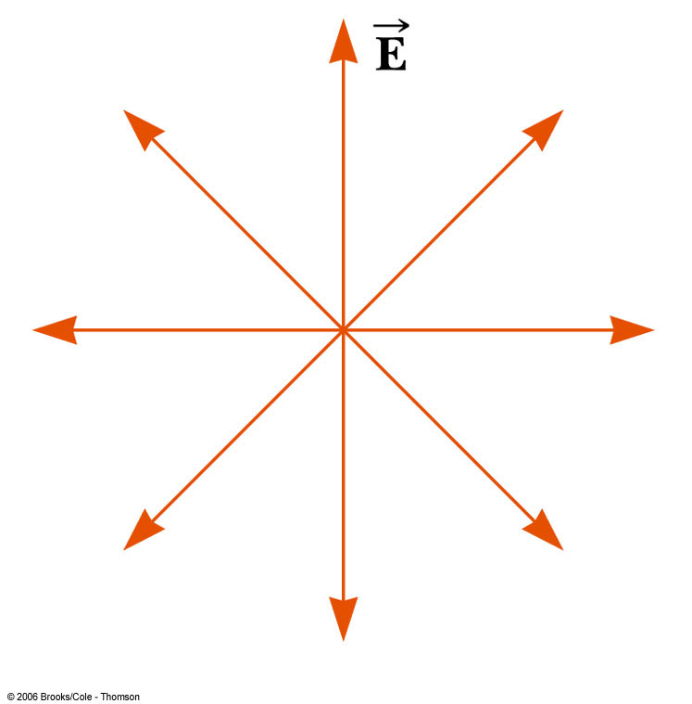
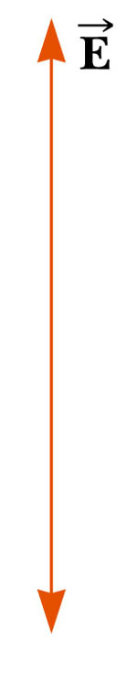
Polarization of Light
An unpolarized wave: each atom produces a wave with its own orientation of E, so all directions of the electric field vector are equally possible and lie in a plane perpendicular to the direction of propagation
A wave is said to be linearly polarized if the resultant electric field vibrates in the same direction at all times at a particular point
Polarization can be obtained from an unpolarized beam by selective absorption, reflection, or scattering

Slide 101
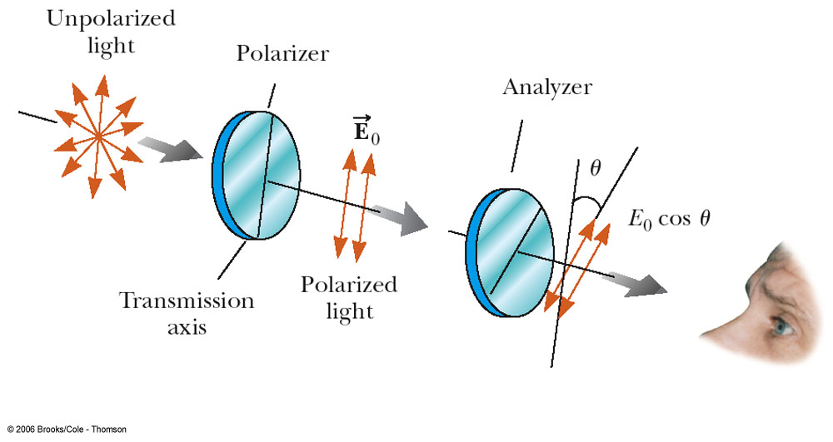
Polarization by Selective Absorption
The most common technique for polarizing light
Uses a material that transmits waves whose electric field vectors in the plane are parallel to a certain direction and absorbs waves whose electric field vectors are perpendicular to that direction

Slide 102
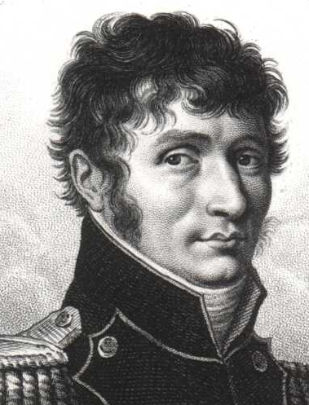
Polarization by Selective Absorption
The intensity of the polarized beam transmitted through the second polarizing sheet (the analyzer) varies as I = I_{o} cos² θ, where I_{o} is the intensity of the polarized wave incident on the analyzer
This is known as Malus’ Law and applies to any two polarizing materials whose transmission axes are at an angle of θ to each other
Étienne-Louis Malus
1775 – 1812

Slide 103
Polarization by Reflection
When an unpolarized light beam is reflected from a surface, the reflected light can be completely polarized, partially polarized, or unpolarized
It depends on the angle of incidence
If the angle is 0° or 90°, the reflected beam is unpolarized
For angles between this, there is some degree of polarization
For one particular angle, the beam is completely polarized

Slide 104
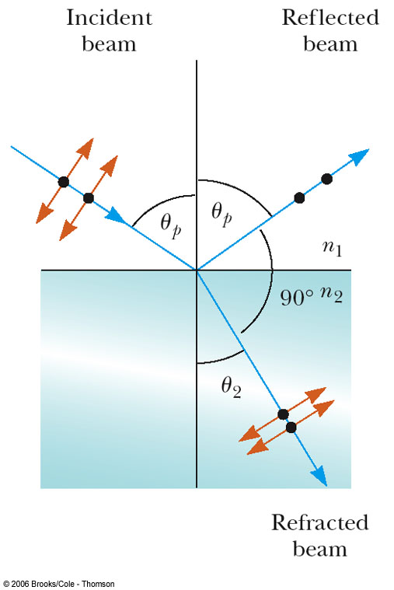
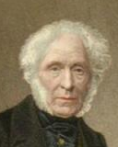
Polarization by Reflection
The angle of incidence for which the reflected beam is completely polarized is called the polarizing (or Brewster’s) angle, θ_{p}
Brewster’s Law relates the polarizing angle to the index of refraction for the material
Sir David Brewster
1781 – 1868

Slide 105
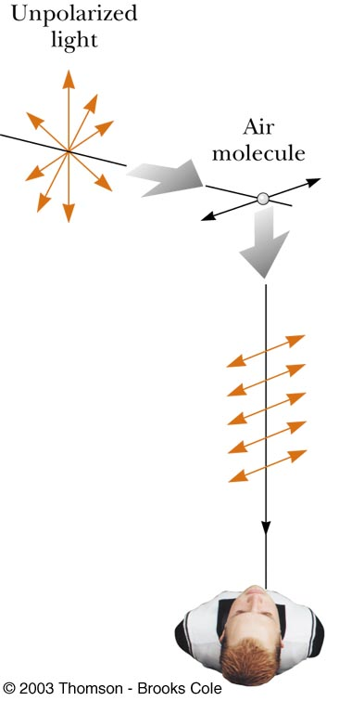
Polarization by Scattering
When light is incident on a system of particles, the electrons in the medium can scatter – absorb and reradiate – part of the light (e.g., sunlight reaching an observer on the earth becomes polarized)
The horizontal part of the electric field vector in the incident wave causes the charges to vibrate horizontally
The vertical part of the vector simultaneously causes them to vibrate vertically
Horizontally and vertically polarized waves are emitted

Slide 106
Problem
Light of intensity I₀ and polarized parallel to the transmission axis of a polarizer, is incident on an analyzer.
If the transmission axis of the analyzer makes an angle of 45° with the axis of the polarizer, what is the intensity of the transmitted light?
What should the angle between the transmission axes be to make I/I₀ = 1/3?

Slide 107
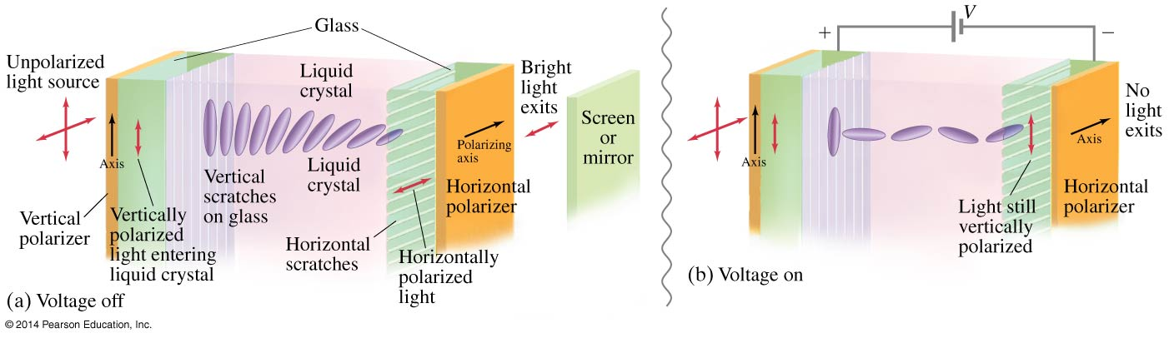
Liquid Crystal Displays (LCD)
Liquid crystals are unpolarized in the absence of an external voltage, and will easily transmit light. When an external voltage is applied, the crystals become polarized and no longer transmit; they appear dark.

Slide 108
Liquid Crystal Displays (LCD)
Liquid crystals can be found in many familiar applications, such as calculators and digital watches.
Color LCD displays are more complicated; each pixel has three subpixels to provide the different colors. A source of light is behind the display (unlike calculators and watches, which use ambient light). The pixels must be able to make finer adjustments than just on and off to provide a clear image.

